Slide 1
Data Types, Variables & Constants in Java

Slide 2
Data Types in Java
Java provides two types of data types:
Primitive Data Types: (byte, short, int, long, float, double, char, boolean)
Non-Primitive Data Types: (String, Arrays, Classes, Interfaces)

Slide 3
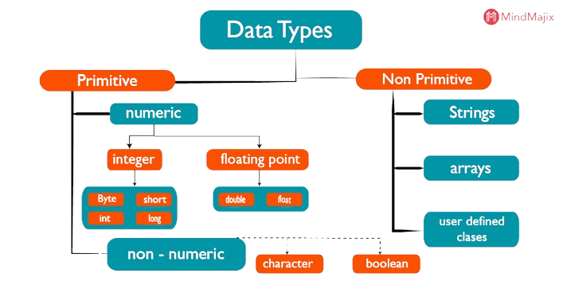

Slide 4
Primitive Data Types
byte (1 byte): -128 to 127
short (2 bytes): -32,768 to 32,767
int (4 bytes): -2B to 2B
long (8 bytes): Large whole numbers
float (4 bytes): Decimal numbers (single precision)
double (8 bytes): Decimal numbers (double precision)
char (2 bytes): Single character
boolean (1 bit): true/false

Slide 5
Example: Primitive Data Types
public class PrimitiveDataTypes {
public static void main(String[] args) {
int num = 100;
float price = 10.5f;
boolean isJavaFun = true;
System.out.println(num + " " + price + " " + isJavaFun);
}
}

Slide 6
Variables in Java
Three types of variables:
Local Variable: Declared inside a method
Instance Variable: Declared inside a class, but outside methods
Static Variable: Declared with the 'static' keyword, shared among objects

Slide 7
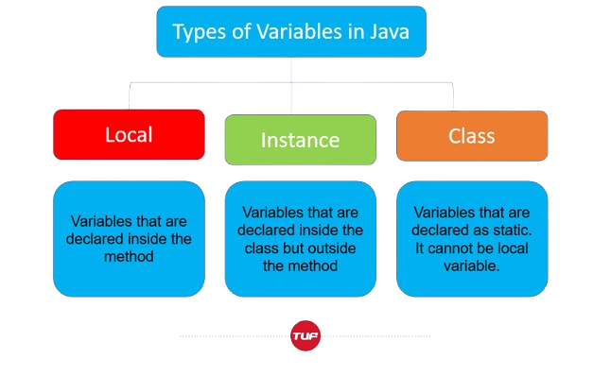
VARIABLES

Slide 8
Example: Variables in Java
class VariablesExample {
int instanceVar = 10;
static int staticVar = 50;
public void display() {
int localVar = 20;
System.out.println(localVar + " " + instanceVar + " " + staticVar);
}
}

Slide 9
Constants in Java
Constants are declared using the 'final' keyword
Once assigned, their value cannot be changed
Used to store fixed values (e.g tax rate)

Slide 10
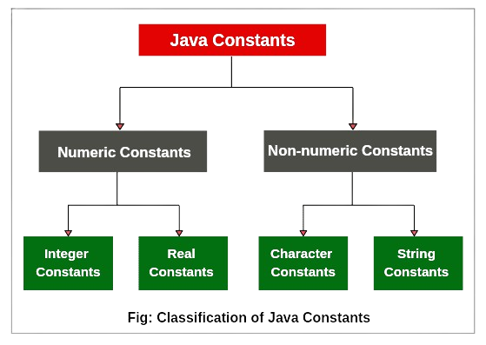
CONSTANTS

Slide 11
Example: Constants in Java
public class ConstantsExample {
public static void main(String[] args) {
final double PI = 3.14159;
System.out.println("Value of PI: " + PI);
}
}

